Slide 1

RPS Game Robot using Reinforcement Learning
Team - DYNAMIC DUDES
Team - DYNAMIC DUDES
AIE19013
AIE19014
AIE19053
Charan Tej. K
Ch. Surya Teja
Abhishek. P

Slide 2





STEP 2
STEP 4
RL Formulation
Implementation
STEP 1
STEP 3
STEP 5
Problem Statement
Hardware Specifications
Results

Slide 3


Problem Statement

Slide 4


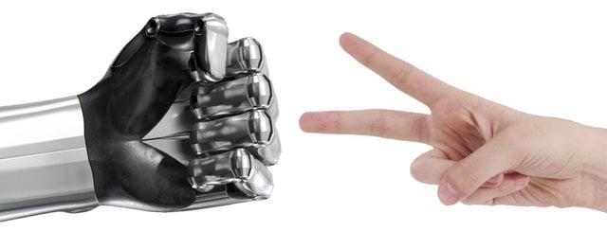
Problem Statement
To design a Robotic hand which uses Reinforcement Learning to play the game of Rock , Paper, Scissor with Human.

Slide 5

RL Formulation

Slide 6

RL Formulation
Agent – Player 1 (Bot) that tries to understand the pattern with the opponent is playing.
State – Rock, Paper, Scissors
Action Space - 0,1,2(Rock, Paper, Scissors)
Environment – In our particular case the opponent itself is the Environment.

Slide 7
RL Formulation
Reward – +1 for a win
-1 for a defeat
0 for a tie
Value – The total reward in each episode serves as our value.
Policy – During exploration if epsilon value is greater than generated random value , the agent randomly chooses any action.
Whereas if epsilon is less than generated random value the agent chooses greedy policy to choose the best action.
“GREEDY POLICY”

Slide 8

Q-Learning

Slide 9

Q-Learning
Q-Learning is a reinforcement learning policy that will find the next best action, given the current state. It chooses this action at random and aims to maximize the reward
Q-learning is called off-policy because the updated policy is different from the behaviour policy. In other words, it estimates the reward for future actions and appends a value to the new state
The Q-function uses the Bellman equation and takes two inputs: state (s) and action
Q(S,A)= Q(S,A) + $∝$[R(S,A) +$γ$ ( max ( Q’ (S’,A’) ) - Q(S,A) ]

Slide 10
Q-Learning
Step 1 – Create an initial Q-table with all Q-values initialized to Zero.
Step 2 – Choose an action and perform it to update values in the table
Step 3 – Get the value of the reward and calculate the value, Q-value by using Bellman Equation
Step 4 – Then continue the same until the table is filled or an episode ends

Slide 11

Hardware Specifications

Slide 12

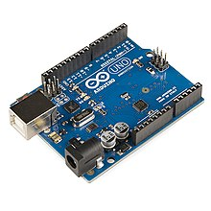
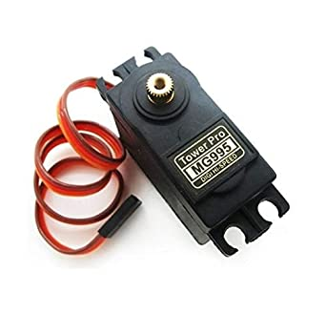
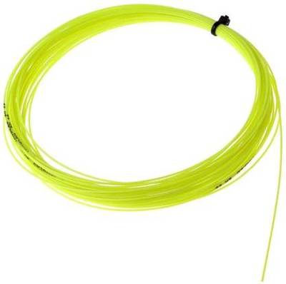
Hardware Specifications
Arduino , 2 MG995 180degree Servo motors, Strings, Jumper wires, USB Arduino cable, cardboard

Slide 13
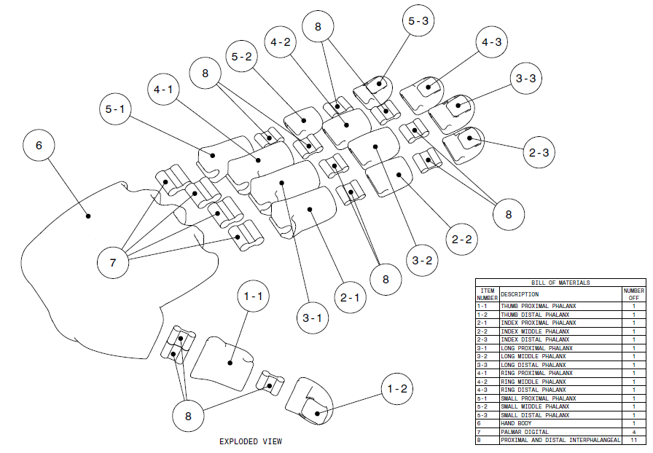
Hardware Specifications
Robot Arm Design

Slide 14
Implementation

Slide 15






Implementation
Hand Recognition
Building RL Agent
Integrating Hardware and Software
$$1^{st}$$
$$2^{nd}$$
$$3^{rd}$$
$$4^{th}$$
$$5^{th}$$
Create Custom Environment
Assembling Hardware
15

Slide 16
Results

Slide 17
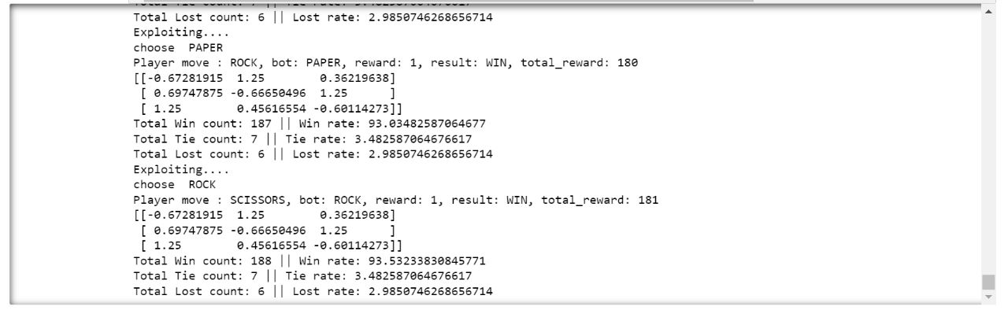
Results
Sequence Pattern - PRS

Slide 18
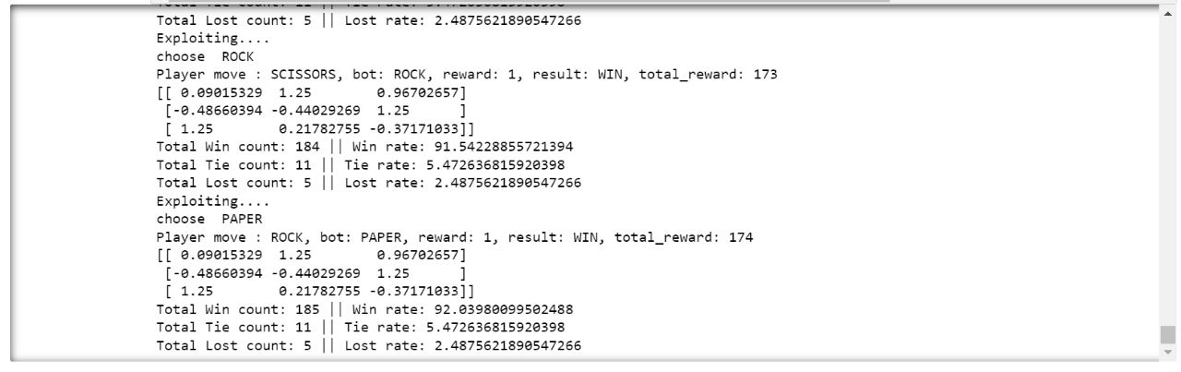
Results
Sequence Pattern - PSR

Slide 19
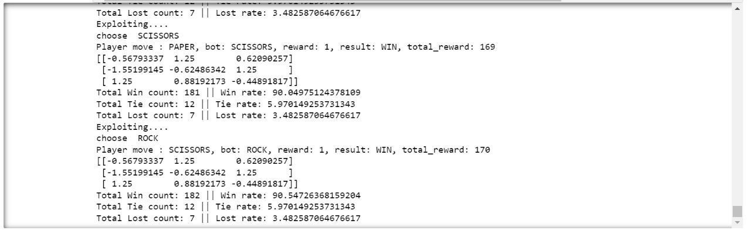
Results
Sequence Pattern - RPS

Slide 20

Conclusion
To the best of our knowledge, we have successfully designed a 3d-printed robot that plays Rock paper scissors game using reinforcement learning
In future , we would like to extend this project by using much more complex patterns for recognition and by also using different available DRL algorithms like DQN, DDQN, etc
&
Future Scope

Slide 21

☺☺☺☺☺☺☺☺☺☺☺☺☺☺☺☺☺☺☺☺
Thank You
☺☺☺☺☺☺☺☺☺☺☺☺☺☺☺☺☺☺☺☺

